Slide 1
MATLAB Programming
Final Exam Two
Instructor: 黃世強 (Sai-Keung Wong)
TAs:黃建洲、林柏全、蔡承恩

Slide 2
Content
There are three problems. You must answer all of them.
You can create new files or functions.

Slide 3
About demo video and demo programs.
A demo video or a demo program may have bugs. They show or illustrate roughly the results. These results may not be exactly the same as the requirements. They are for your own reference. You must follow the instruction to finish your programs.

Slide 4
Program file name format
Write all your programs in a folder. The folder name is mat_exam_02_student_ID. For example, if your ID is 12345678, the folder name is mat_exam_02_12345678.
Zip the folder and upload it.
Write a program for each problem in one file.
The file name is ex02_X_yourStudentID.m, where X is the problem number.
For example, if your student ID is 12345678 and the problem number is 3, then the file name must be ex02_3_12345678.m.
You must not output all the intermediate results.
Output the results that are required only.

Slide 5
File content header
At the top of the file, write down your name, ID, email address, department, and date. If you do not do so, you receive a score of zero in the corresponding problem.
%%%%%%%%%%%%%%%%%%%%%%%%%%%
% Final Exam Number: …
% Problem number: …
% Student Name: …
% Student ID: …
% Email address: …
% Department:
% Date: ….
%%%%%%%%%%%%%%%%%%%%%%%%%%%%

Slide 6
File content
For each problem, display the problem number before showing the results.
close all; clear; clc; % close all windows
% clear variables, and clear screen
disp('Exam Problem 2.1') % show Exam Problem 2.1

Slide 7
(50%) Problem 2.1. Probability density function
Assume that Y is generated randomly in a uniform manner inside (0,1).
We have
X1 = F1(Y) = b/a * cos ( a * π * Y ² /2)
X2 = F2(Y) = b – a * cos ( a * Y ² /2)
Initially, a = 0.3 and b = 0.2. a must be inside [0.1, 1.0].
Use LineWidth = 3. And set(gca, 'Fontsize',15).
Use a callback function to handle the key events.
‘1’: decrease a by 0.1.
‘2’: increase a by 0.1.

Slide 8
Problem 2.1. Tasks
Press ‘q’ to show your name and ID on the console window. Then quit the program.
Clear the figure(s). Use a 1x2 grid to draw figures.
Randomly generate n samples of Y. n must be 10000.
Draw the pdf of X1. Use subplot(1,2, 1) to draw it on the left side.
Draw the pdf of X2. Use subplot(1,2, 2) to draw it on the right side.
Show the titles of the two figures similar to the demo figures.
Report the average (M) and standard deviation (SD) of the n samples as the title of the figure. Also, report a and b. The format is: Mean= …; SD= …; a=… b = …;
Animate a point to move along the curve of the pdf from left to right in each subplot. The animation must be interactive.
9. ‘1’: decrease a by 0.1.
10. ‘2’: increase a by 0.1.

Slide 9
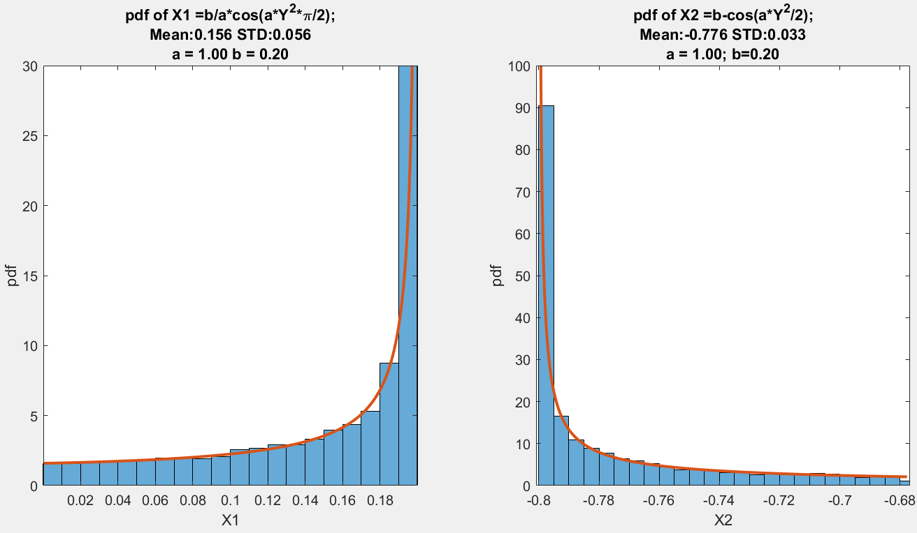

Slide 10
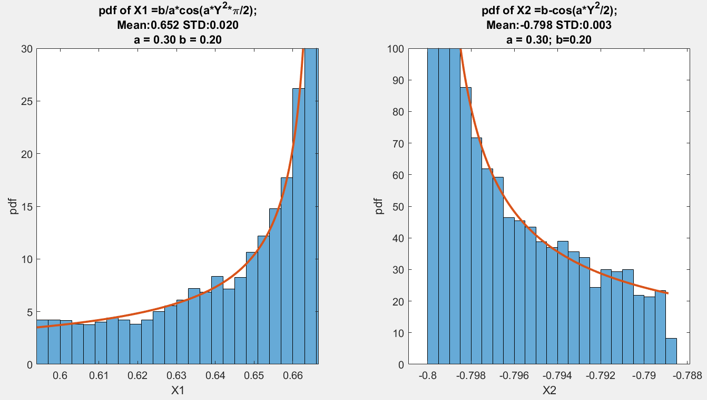

Slide 11
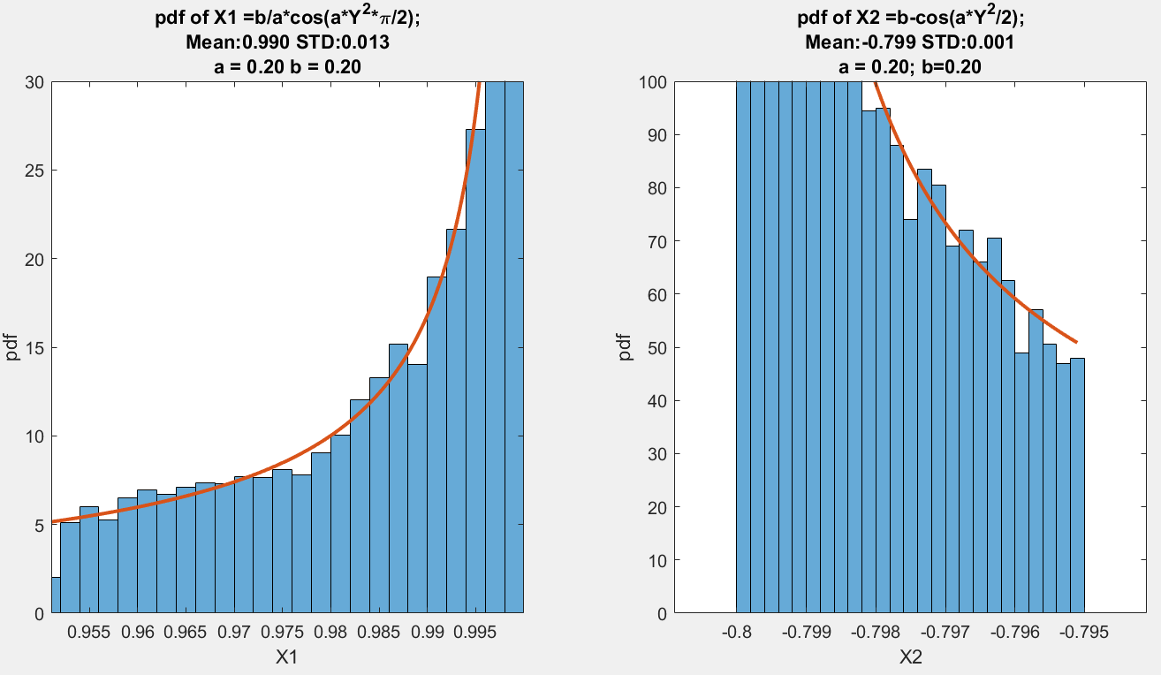

Slide 12
Problem 2.1. Marking Scheme (50%)
[1%] Press ‘q’ to show your name and ID on the console window. Then quit the program. You must implement this or your score is zero.
[11%] Draw the pdf of X1 correctly. Use subplot(1,2, 1) to draw it on the left.
[11%] Draw the pdf of X2 correctly. Use subplot(1,2, 2) to draw it on the right side.
[3%] Show the titles of the two figures similar to the demo figures.
[4%] Report the average (M) and standard deviation (SD) of the n samples as the title of the figure. Also, report a. The format is: Mean= …; SD= …; a=… b = …; The font size and line width are correct.
[4%] Animate a point (e.g., circle) to move along the curve of the pdf from left to right in each subplot. The animation must be interactive.
[3%] The key ‘1’ is handled correctly. The two pdf curves for X1 and X2 are correct.
[3%] The key ‘2’ is handled correctly. The two pdf curves for X1 and X2 are correct.

Slide 13
Problem 2.2. Function Graph
This page is empty.

Slide 14
(30%) Problem 2.2. Function Graph
Tasks
Show student ID and name. You implement this item or your score is zero.
Press ‘n’ to view each of the items in F in a backward order. Use layout 1x1.
Press ‘m’ to view each of the items in F in a forward order. Use layout 1x1.
Press ‘s’ to show all the plots of the 10 functions (see instruction). The layout is 2x5, i.e., 2 rows and 5 columns.

Slide 15
Problem 2.2. (30%)
The following diagrams show how the inputs are computed to produce new values. Note that if the inputs are vectors, operations are performed in the array format.
h
a
x
g
x
x
g
g(x)
g
g(x,y)
k
b
y
A function accepts one parameter, x. It produces a new value g(x).
y
A function accepts two parameters, x and y. It produces a new value g(x,y). Note the parameters must be ordered correctly.
This diagram performs:
a = h(g(x)), and b = k(g(x), y).

Slide 16
Problem 2.2.
Write a program to implement the following function network:
g₁₁
g₄₁
g₆₁
g₂₁
x
g₅₁
g₃₁
g₁₂
g₄₂
g₂₂
g₁₃
g₃₂
g₄₃
y
g₅₂
g₂₃
g₁₄
g₄₄

Slide 17
Problem 2.2.
We denote the output computed by function g_{ij} as k_{ij}. Note the order of the inputs is important. The inputs are ordered from top to bottom of a node.
a
a
k_{ij}
g_{ij}
k_{ij}
g_{ij}
b
b
k_{ij =} g_{ij}(a, b)
k_{ij =} g_{ij}(b, a)

Slide 18
Problem 2.2.
We denote the output computed by function g_{ij} as k_{ij}. Note the order of the inputs is important. The inputs are ordered from top to bottom of a node.
a
a
g_{ij}
k_{ij}
g_{ij}
k_{ij}
b
c
b
c
k_{ij =} g_{ij}(a, b,c)
k_{ij =} g_{ij}(c,b, a)

Slide 19
Problem 2.2.
Assume that the inputs are a and b. The functions are defined as follows.
Note that you must interpret the operators properly.
Layer1 | Layer 2 | Layer 3 | Layer 4 | Layer 5 | Lay 6
g₁₁(a,b) = cos(a).*sin(b) | g₂₁(a,b) = cos(a+b) | g₃₁(a,b) = sin(b).*cos(a) | g₄₁(a,b) = b.*cos(2a) | g₅₁(a,b) = sin(a)./(b.*b+2) | g₆₁(a,b,c)= a.*b + c
g₁₂(a,b) = b.*sin(a) | g₂₂(a,b) = a+b.*(sin(b)+2) | g₃₂(a,b) = sin(a)+cos(b) | g₄₂(a,b) = b.*sin(2a) | g₅₂(a,b) = a.*cos(5b)
g₁₃(a,b) = cos(a).*sin(b) | g₂₃(a,b) = sin(a).*(sin(|b|)+1) |  | g₄₃(a,b) = |b|.*sin(2a)
g₁₄(a,b) = a.*sin(b) |  |  | g₄₄(a,b) = |a|.*cos(2b)

Slide 20
Problem 2.2.
Set x in [-2.5, 2.5] and y in [-2.5, 2.5]. The step size is 0.05.
F = [k11; k12; k13; k14; k21; k22; k23; k31; k32; k41; k42; k43; k44; k51; k52; k61];
Plot each data set in F. A data set represents a mesh. Label the x-axis and the y-axis.
Hint: To draw a mesh, use the followings:
s0 = index*101+1-101; % Note kij’s dimension is 101x101.
s1 = index*101+101-101;
Z = F(s0:s1,:);
meshc(X,Y,Z)
colorbar
X and Y are produced by meshgrid.
Z contains the values for all the combinations of x and y in the grid of X and Y.

Slide 21
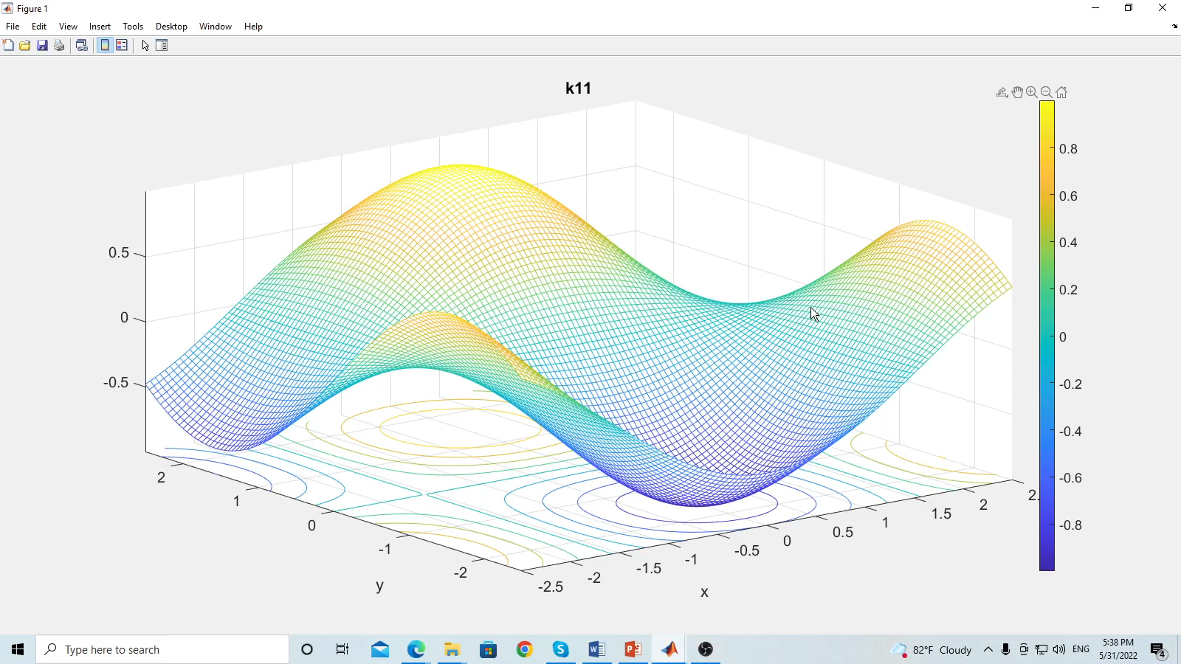
Problem 2.2.
Play to see each item
Press ‘n’ to view each of the items in F in a backward order.
Press ‘m’ to view each of the items in F in a forward order.

Slide 22
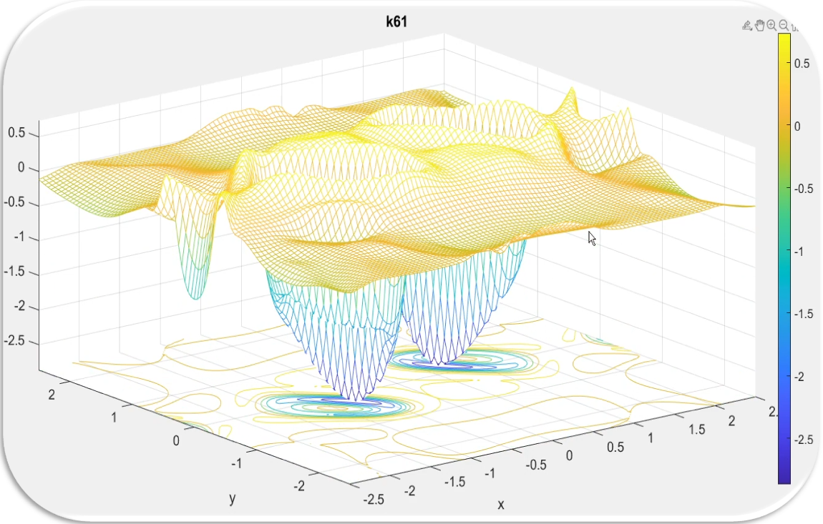
Result for k61

Slide 23
Problem 2.2. Marking Scheme.
The items must be done correctly.
We check the items in [k23; k31; k32; k41; k42; k43; k44; k51; k52; k61 ], i.e., 10 functions.
[1%]: Press ‘q’ to show the student ID and name. Then quit the program. You implement this item or your score is zero.
[2%*10]: Each mesh is correct; its title is correct; and the axis interval is correct.
[4%]: ‘m’ and ‘n’ work well.
[5%] Press ‘s’ to show all the plots of the 10 functions. The layout is 2x5. All plots for the functions are correct.
We will not modify your script. If your program does not support ‘n’ and ‘m’, your score is zero.

Slide 24
Problem 2.3. Galaxy system
This page is empty.

Slide 25
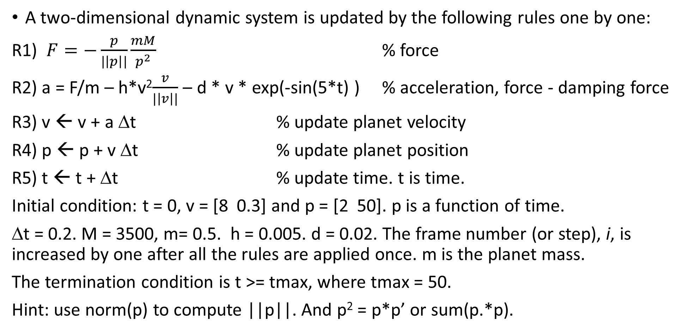
Problem 2.3. Galaxy system (20%)
A two-dimensional dynamic system is updated by the following rules one by one:
R1) $F=−\frac{p}{|\left|p\right||}\frac{mM}{p^{2}}$ % force
R2) a = F/m – h*v²$\frac{v}{|\left|v\right||}$ – d * v * exp(-sin(5*t) ) % acceleration, force - damping force
R3) v ← v + a Δt % update planet velocity
R4) p ← p + v Δt % update planet position
R5) t ← t + Δt % update time. t is time.
Initial condition: t = 0, v = [8 0.3] and p = [2 50]. p is a function of time.
Δt = 0.2. M = 3500, m= 0.5. h = 0.005. d = 0.02. The frame number (or step), i, is increased by one after all the rules are applied once. m is the planet mass.
The termination condition is t >= tmax, where tmax = 50.
Hint: use norm(p) to compute ||p||. And p² = p*p’ or sum(p.*p).

Slide 26
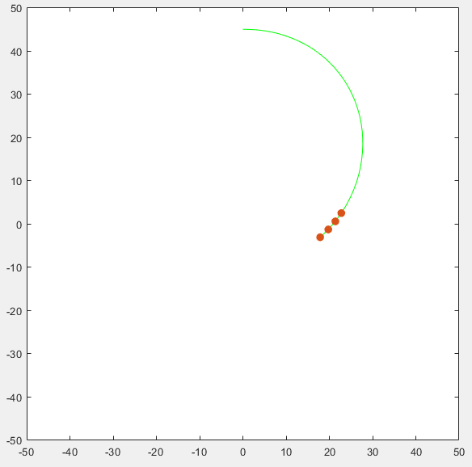
Problem 2.3
Draw the trajectory of the planet. The planet must be rotating around the origin (0,0) at the beginning.
Must use
axis( [-50 50 -50 50] );
pbaspect( [1 1 1] ).
Draw N recent sample points of the trajectory of the planet. The N points must be drawn clearly. Use markers to draw the points. Set the marker size as 25.
By default N is 1.
Press ‘k’ to increase N by 1 each time.

Slide 27
Problem 2.3. Tasks
Press ‘q’ to show student ID and name. Then quit the program.
Press ‘m’ to increase M by 100. Here, M <= 4000
Press ‘k’ to increase N by 1. Here, N <= 10
Show N and M as the title of the figure.
Press ‘s’ to stop or resume the simulation.
Show the total travel distance as the title of the distance figure.
Show the average speed as the title of the speed figure.
Press ‘r’ to reset. Restore the initial values of all the variables.
Hint: Total distance computation
dp = v.*dt; total_distance = total_distance+sqrt(dp*dp');

Slide 28
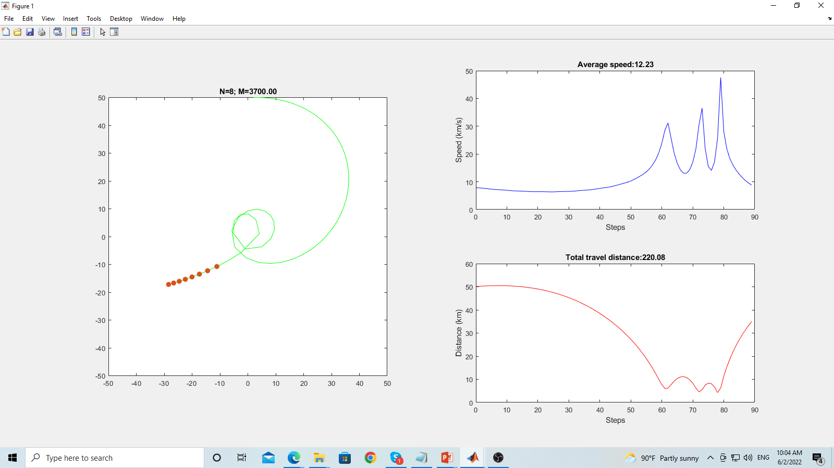
Problem 2.3. Display modes
The figure window must be set on top of all other windows.
Display the trajectory curve of the planet,
speed curve, and distance curve.
The layout must be the same as the right figure.
The trajectory curve must be green.
The speed curve must be blue.
The distance curve must be red.
Label the x-axis and y-axis properly.
Use the following labels:
Speed curve (km/s) and Distance (km)
The x-axis refers to the number of simulation time steps.
Trajectory
Speed figure
distance figure

Slide 29
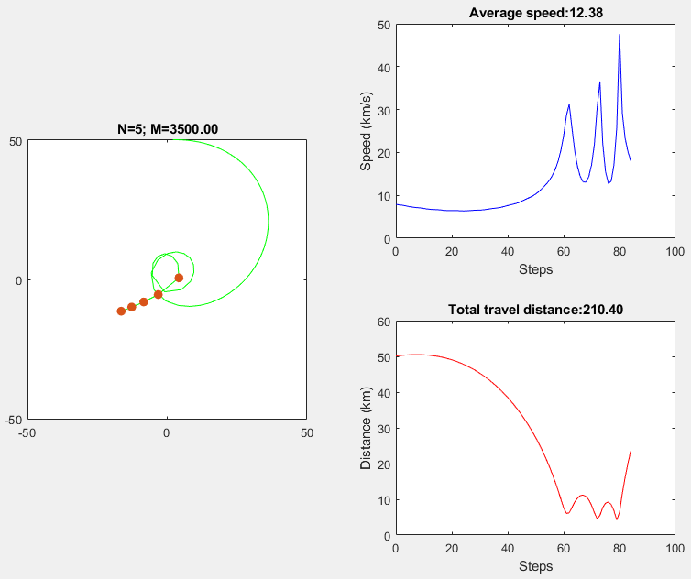
Speed figure
Trajectory
distance figure

Slide 30
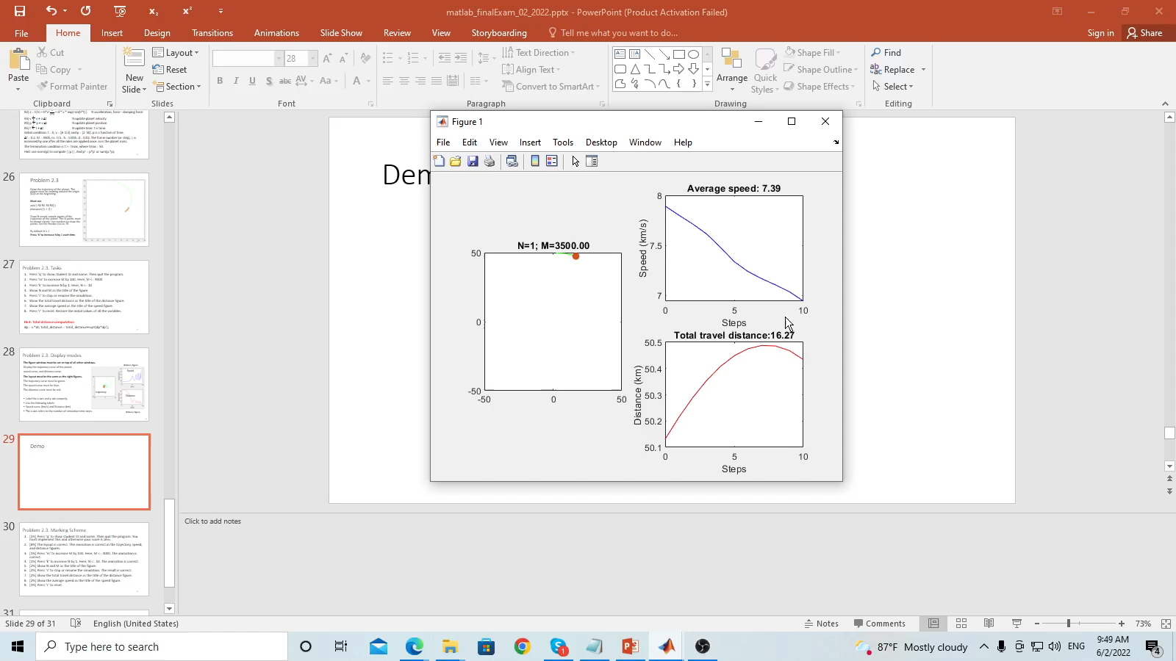
Play to see the animation

Slide 31
Problem 2.3. Marking Scheme (20%)
[1%] Press ‘q’ to show student ID and name. Then quit the program. You must implement this and otherwise your score is zero.
[5%] The layout is correct. The animation is correct in the trajectory, speed, and distance figures.
[2%] Press ‘m’ to increase M by 100. Here, M <= 4000. The animation is correct.
[2%] Press ‘k’ to increase N by 1. Here, N <= 10. The animation is correct.
[2%] Show N and M as the title of the figure.
[2%] Press ‘s’ to stop or resume the simulation at any time. The result is correct.
[2%] Show the total travel distance as the title of the distance figure.
[2%] Show the average speed as the title of the speed figure.
[2%] Press ‘r’ to reset at any time. The result is correct.

Slide 32
End
Enjoy MATLAB Programming.

